Slide 1
بِسْمِ ٱللَّهِ ٱلرَّحْمَٰنِ ٱلرَّحِيمِ

Slide 2
Course: Web Designing
Institute: Corvit Systems Peshawar
Duration: 3-Month Web Designing & Development Course
4th class of JS (Java script)
Topic : Loops (for, while, Do while) loops

Slide 3
Instructor: Muhammad Sahil
BS in Computer Science – University of Peshawar
1 Year MERN Stack Developer – E Digital Pakistan (KPITB)
1 Year Web Instructor – E Digital Pakistan
6 Months Web Instructor – University of Peshawar
Computer Science Teacher – Alflah Model College, Sarband
Experience with multiple local client projects
Full Stack / MERN Stack Web Developer | Web Instructor

Slide 4
What Are Loops in Programming?
Loops are used to execute the same block of code multiple times
They are essential for handling collections of data and repeated tasks
Loops reduce redundancy and improve performance
Almost every real software system depends on loops
Without loops, automation in programming is not possible

Slide 5
for Loop – Fixed and Predictable Tasks
Used when the number of iterations is known in advance
Commonly used to traverse arrays with a known length
Ideal for processing records with fixed limits
Used in generating reports, tables, and indexes
Example use case: processing 100 database records fetched at once

Slide 6
while Loop – Condition-Driven Execution
Used when the number of iterations is not known beforehand
The loop continues as long as a condition remains true
Common in input validation and background processes
If the condition is false initially, the loop does not execute
Example use case: keep reading user input until valid data is entered

Slide 7
do…while Loop – Mandatory First Execution
Used when at least one execution is required
Condition is checked after executing the loop body
Ensures minimum one run regardless of condition
Useful in user interaction and menu-based systems
Example use case: show a menu once before checking user choice

Slide 8
Why for Loop Alone Is Not Enough
for loop requires a predefined start and end
Many programming problems do not have fixed iteration counts
Condition-based logic cannot be naturally expressed using for loops
Using for loop in such cases makes code complex and unreadable
Different loop types exist to match different program behaviors

Slide 9
Practical Programming Comparison
for loop is used for array processing and indexed data
while loop is used for validation and continuous checks
do…while loop is used for menus, retries, and confirmations
Each loop matches a specific control-flow requirement
Choosing the correct loop improves code clarity and reliability

Slide 10
Code example Screen shots from next slide

Slide 11
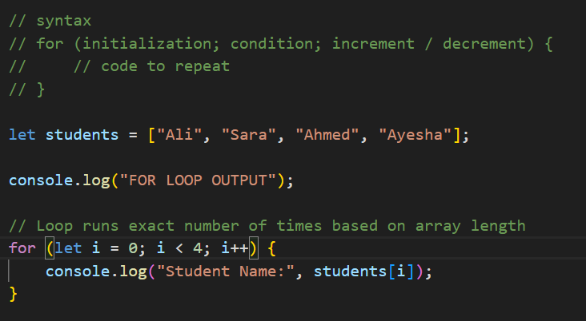
For Loop syntax and example

Slide 12
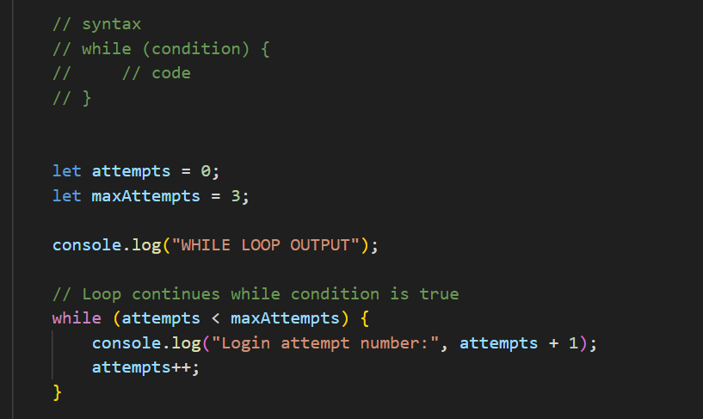
While loop

Slide 13
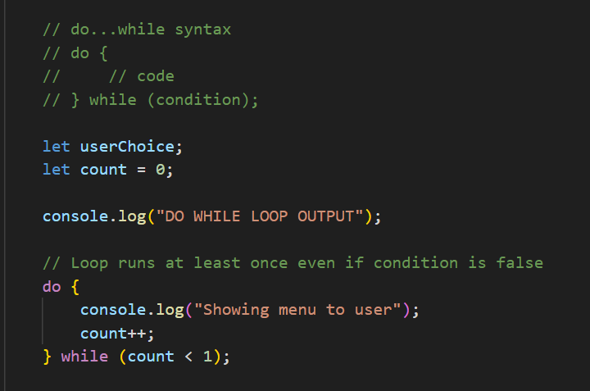
Do while loop

Slide 14
Summary
Loops are design tools, not alternatives
for loop handles predictable iterations
while loop handles unknown iteration counts
do…while loop guarantees at least one execution
Professional programmers choose loops based on logic, not preference

